Slide 1
CPU Scheduling

Slide 2
Objectives
CPU Scheduling, which is the basis of multiprogrammed operating systems
Objective is to maximize CPU utilization.
By switching the CPU among processes, the operating system can make the computer more productive.
In this lecture we learn;
Some basic CPU scheduling concepts
Scheduling Criteria
Several CPU Scheduling Algorithms
Selecting an algorithm for a particular system.

Slide 3
On modern operating systems it is kernel level threads –not processes– that are in fact being scheduled by operating system.
However, the terms “ process scheduling” and thread scheduling are often used interchangeably.

Slide 4
Basic Concepts
CPU-I/O Burst Cycle
CPU Scheduler
Preemptive and Non-preemptive scheduling
Dispatcher

Slide 5
CPU-I/O Burst Cycle
The success of CPU scheduling depends on an observed property of processes:
process execution consists of a cycle of CPU execution and I/O wait.
Processes alternate between these two states.
Process execution begins with a CPU burst.
That is followed by an I/O burst,
which is followed by another CPU burst, then another I/O burst, and so on.
Eventually, the final CPU burst ends with a system request to terminate execution
An I/O bound program typically has many short CPU bursts. And a CPU-bound program might have few long CPU bursts.
Duration of the CPU bursts have been measured extensively.

Slide 6
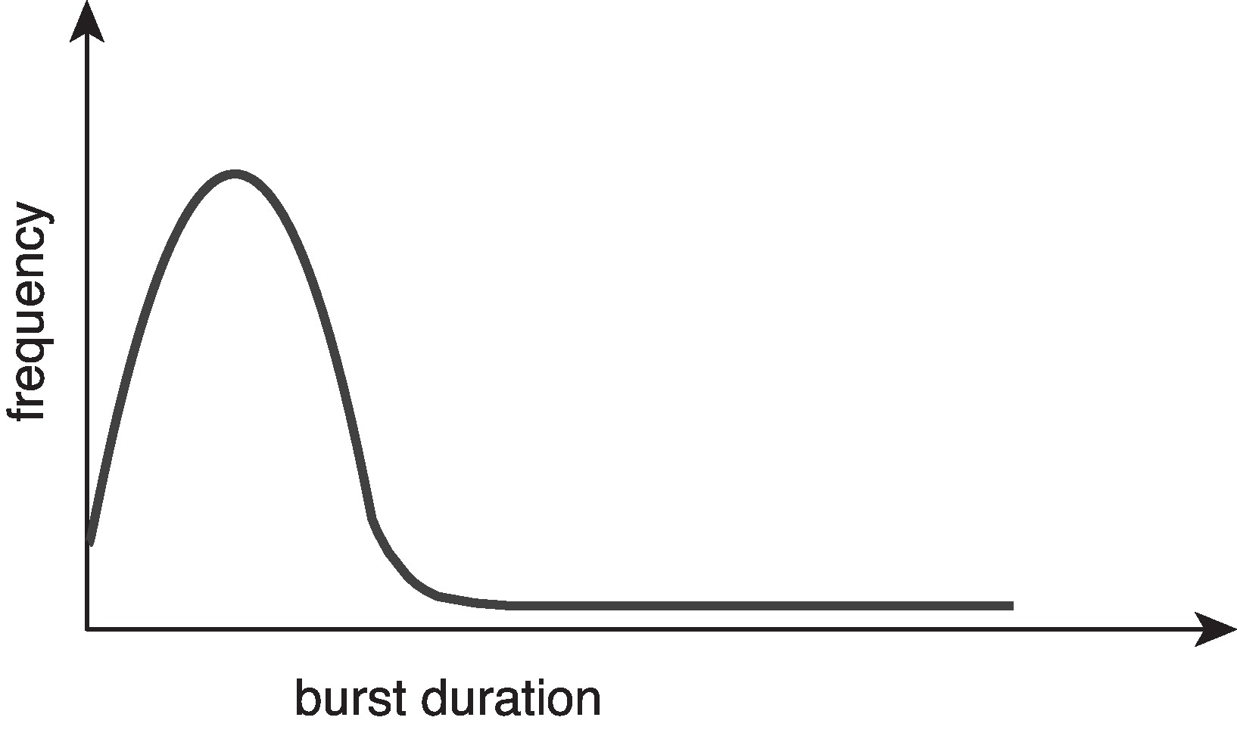
Histogram of CPU-burst Times
Large number of short bursts
Small number of longer bursts

Slide 7
CPU Scheduler
Whenever the CPU becomes idle, the operating system must select one of the processes in the ready queue to be executed.
The CPU scheduler also called short-term scheduler , selects a process from the processes in memory that are ready to execute and allocates the CPU to that process.
The ready queue is not necessarily a first-in, first-out (FIFO) queue.
It can be implemented as a FIFO queue, a priority queue, a tree, or simply an unordered linked list.
The records in the queues are generally process control blocks (PCBs) of the processes.

Slide 8
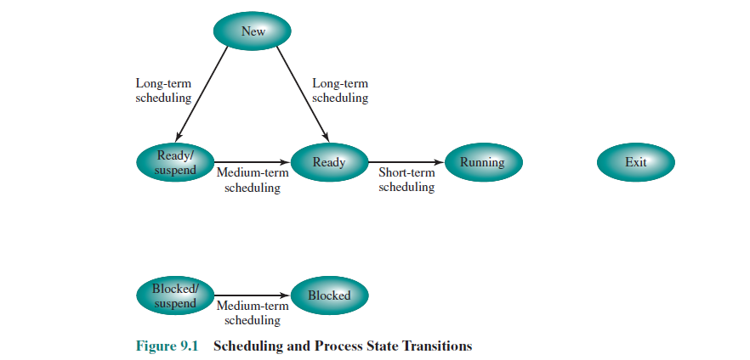

Slide 9
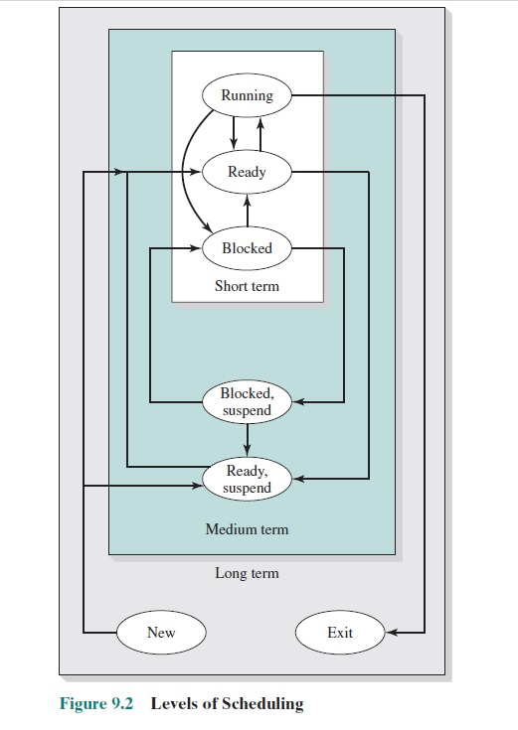

Slide 10
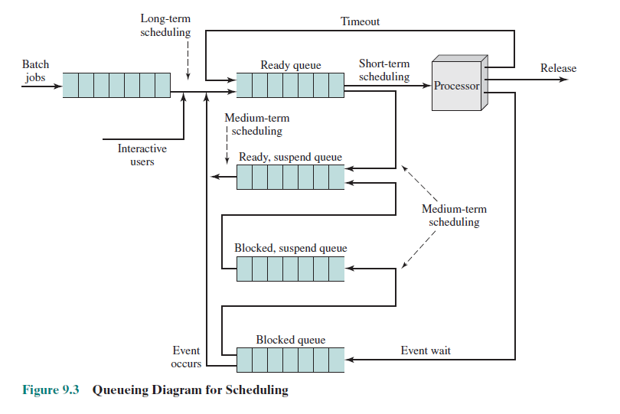

Slide 11
Preemptive and non-preemptive scheduling
CPU scheduling decisions may take place when a process:
Switches from running to waiting state
Switches from running to ready state
Switches from waiting to ready
Terminates
Scheduling under 1 and 4 is non-preemptive or cooperative
once the CPU has been allocated to a process, the process keeps the CPU until it releases the CPU either by terminating or by switching to the waiting state.
All other scheduling is preemptive
Consider access to shared data
preemptive scheduling can result in race conditions
Consider preemption while in kernel mode
Consider interrupts occurring during crucial OS activities

Slide 12
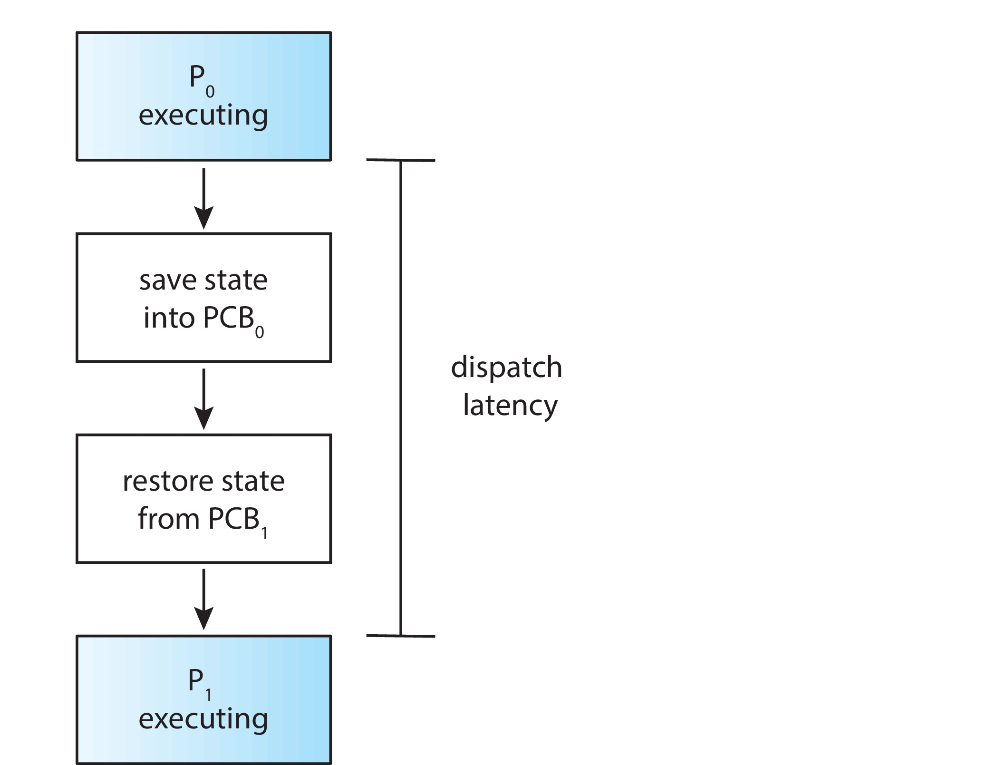
Dispatcher
Another component involved in the CPU-scheduling function is the dispatcher.
The dispatcher is the module that gives control of the CPU to the process selected by the short-term scheduler.
This function involves the following:
Switching context
Switching to user mode
Jumping to the proper location in the user program to restart that program
The dispatcher should be as fast as possible, since it is invoked during every process switch.
Dispatch latency – time it takes for the dispatcher to stop one process and start another running

Slide 13
An interested question is, how often do context switches occur?
$ vmstat 1 3
Output:
----cpu-----
24
225
339
cat /proc/2166/status
Output:
voluntay_ctxt_switches 150
nonvoluntay_ctxt_switches 8

Slide 14
Scheduling Criteria
CPU utilization – keep the CPU as busy as possible
CPU utilization can range from 0 percent to 100 percent
In real systems it should range from 40 percent to 90 percent.
Throughput – number of processes that complete their execution per time unit
Turnaround time --The interval from the time of submission of a process to the time of completion is the turnaround time.
From the point of view of a particular process, it is an important criterion.
It is the sum of the periods spent waiting to get into memory, waiting in the ready queue, executing on the CPU, and doing I/O.
Waiting time – amount of time a process has been waiting in the ready queue
The CPU-scheduling algorithm does not affect the amount of time during which a process executes or does I/O. It affects only the amount of time that a process spends waiting in the ready queue.
Response time – amount of time it takes from when a request was submitted until the first response is produced, not output (for time-sharing environment)
In an interactive system, turnaround time may not be the best criterion.

Slide 15
Scheduling Algorithm Optimization Criteria
Maximize →CPU utilization and throughput
Minimize → turnaround time, waiting time, and response time.
In most cases, we optimize the average measure. However, under some circumstances, we prefer to optimize the minimum or maximum values rather than the average.
For example, to guarantee that all users get good service, we may want to minimize the maximum response time not average response time.
Investigators have suggested that, for interactive systems (such as desktop systems), it is more important to minimize the variance in the response time than to minimize the average response time.
A system with reasonable and predictable response time may be considered more desirable than a system that is faster on the average but is highly variable.

Slide 16
Scheduling Algorithms

Slide 17
First- Come, First-Served (FCFS) Scheduling
Process Burst Time
P₁ 24
P₂ 3
P₃ 3
Suppose that the processes arrive in the order: P₁ , P₂ , P₃ The Gantt Chart for the schedule is:
Waiting time for P₁ = 0; P₂ = 24; P₃ = 27
Average waiting time: (0 + 24 + 27)/3 = 17

Slide 18
FCFS Scheduling (Cont.)
Suppose that the processes arrive in the order:
P₂ , P₃ , P₁
The Gantt chart for the schedule is:
Waiting time for P₁ = 6; P₂ = 0; P₃ = 3
Average waiting time: (6 + 0 + 3)/3 = 3
Much better than previous case
Convoy effect - short process behind long process
Consider one CPU-bound and many I/O-bound processes

Slide 19
Shortest-Job-First (SJF) Scheduling
Shortest Next CPU Burst algorithm
Associate with each process the length of its next CPU burst
Use these lengths to schedule the process with the shortest time
SJF is optimal – gives minimum average waiting time for a given set of processes
The difficulty is knowing the length of the next CPU request
Could ask the user

Slide 20
Example of SJF
Burst Time
P₁ 6
P₂ 8
P₃ 7
P₄ 3
SJF scheduling chart
Average waiting time = (3 + 16 + 9 + 0) / 4 = 7

Slide 21

Determining Length of Next CPU Burst
Can only estimate the length – should be similar to the previous one
Then pick process with shortest predicted next CPU burst
Can be done by using the length of previous CPU bursts, using exponential averaging
Commonly, α set to ½
Preemptive version called shortest-remaining-time-first

Slide 22
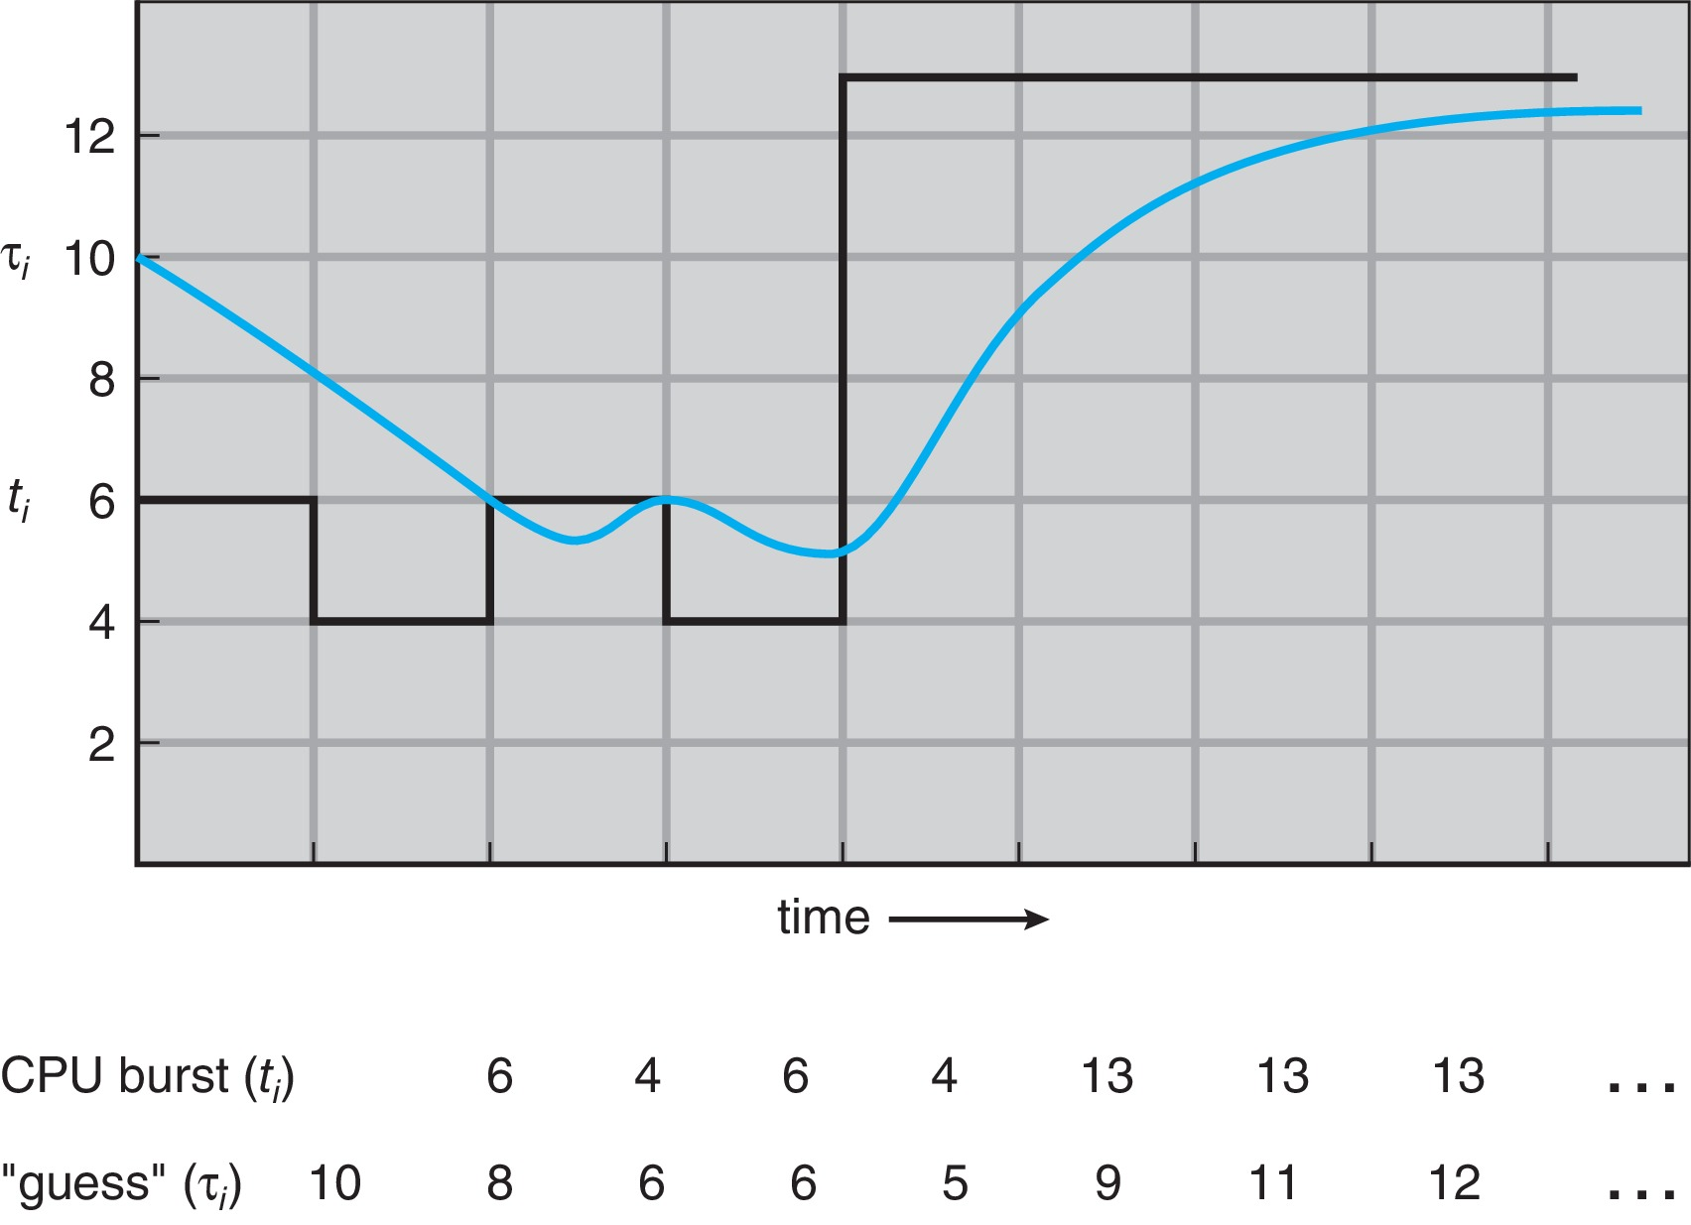
Prediction of the Length of the Next CPU Burst

Slide 23
Examples of Exponential Averaging
α =0
τ_{n+1} = τ_{n}
Recent history does not count
α =1
τ_{n+1} = α t_{n}
Only the actual last CPU burst counts
If we expand the formula, we get:
τ_{n+1} = α t_{n}+(1 - α)α t_{n} ₋₁ + …
+(1 - α )^{j} α t_{n} _{-j} + …
+(1 - α )^{n +1} τ₀
Since both α and (1 - α) are less than or equal to 1, each successive term has less weight than its predecessor

Slide 24
Example of Shortest-remaining-time-first
Now we add the concepts of varying arrival times and preemption to the analysis
Process Arrival Time Burst Time
P₁ 0 8
P₂ 1 4
P₃ 2 9
P₄ 3 5
Preemptive SJF Gantt Chart
Average waiting time = [(10-1)+(1-1)+(17-2)+(5-3)]/4 = 26/4 = 6.5 msec

Slide 25
Round Robin (RR)
Each process gets a small unit of CPU time (time quantum q), usually 10-100 milliseconds. After this time has elapsed, the process is preempted and added to the end of the ready queue.
If there are n processes in the ready queue and the time quantum is q, then each process gets 1/n of the CPU time in chunks of at most q time units at once. No process waits more than (n-1)q time units.
Timer interrupts every quantum to schedule next process
Performance
q large ⇒ FIFO
q small ⇒ q must be large with respect to context switch, otherwise overhead is too high

Slide 26
Example of RR with Time Quantum = 4
Process Burst Time
P₁ 24
P₂ 3
P₃ 3
The Gantt chart is:
Typically, higher average turnaround than SJF, but better response
q should be large compared to context switch time
q usually 10ms to 100ms, context switch < 10 µsec

Slide 27
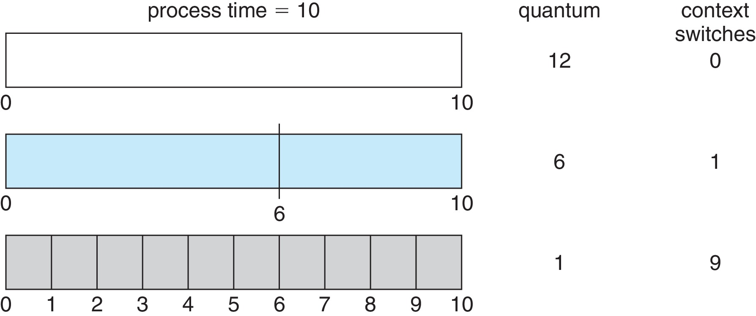
Time Quantum and Context Switch Time

Slide 28
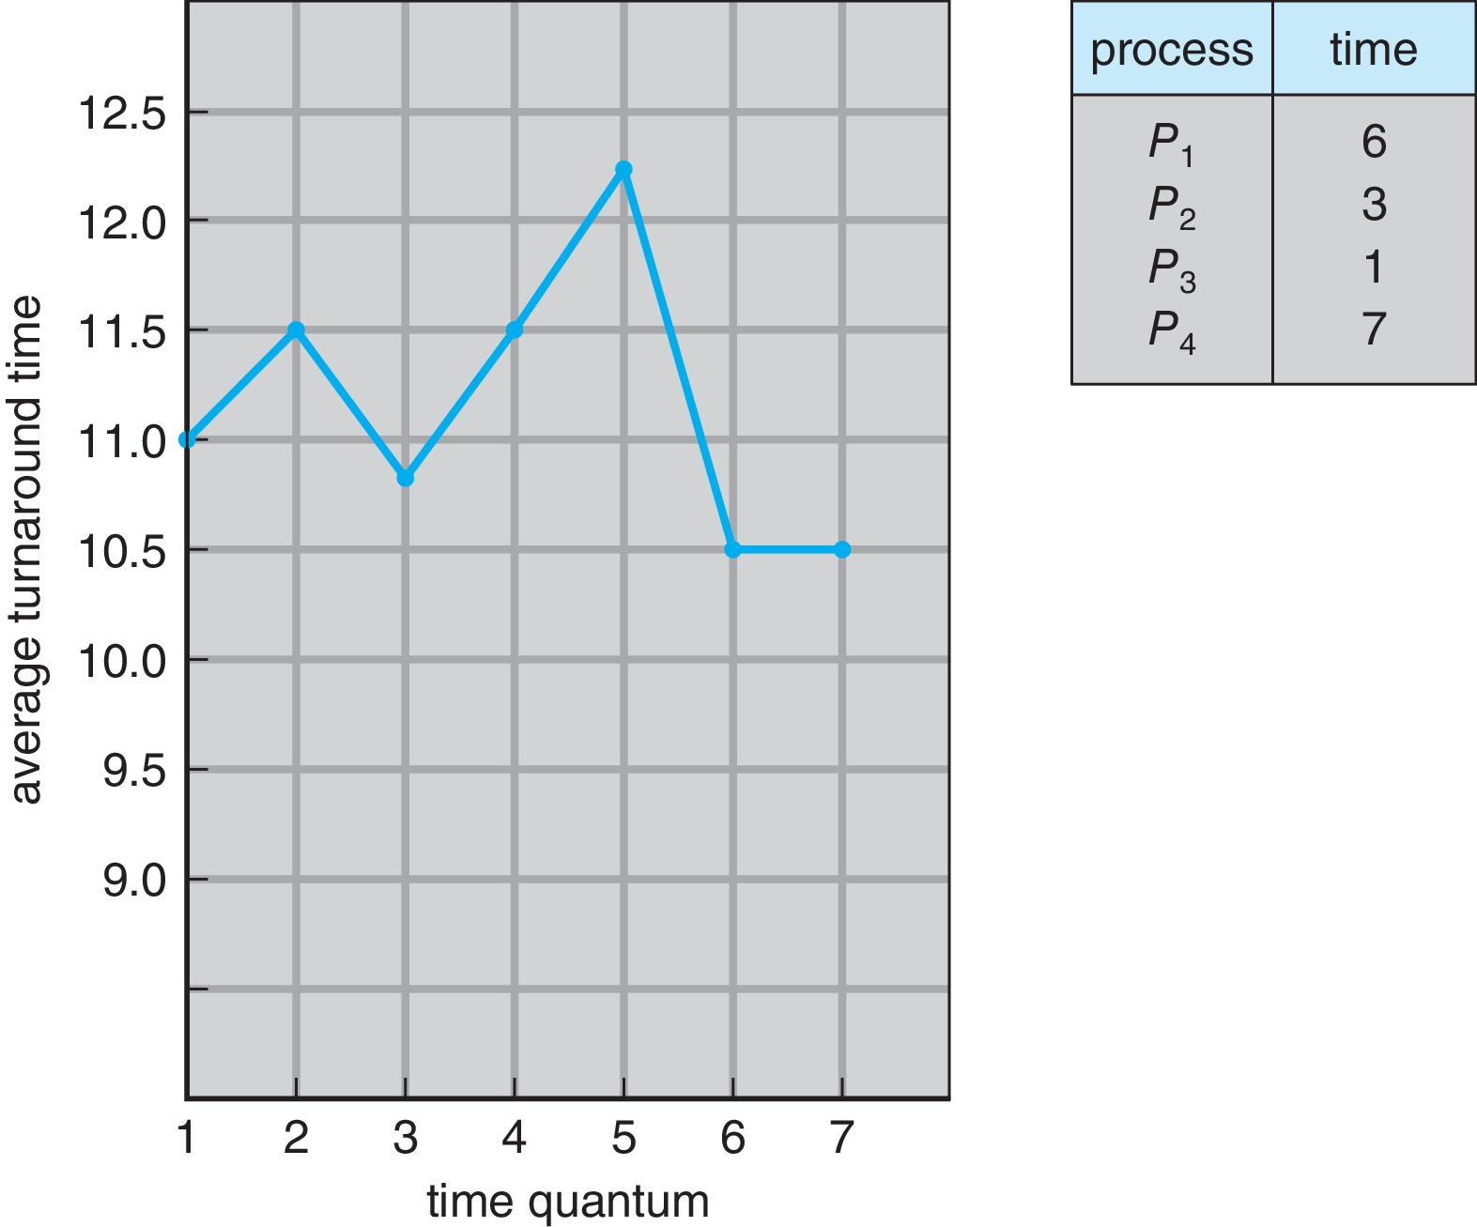
Turnaround Time Varies With The Time Quantum
80% of CPU bursts should be shorter than q

Slide 29
Priority Scheduling
A priority number (integer) is associated with each process
The CPU is allocated to the process with the highest priority (smallest integer ≡ highest priority)
Preemptive
Nonpreemptive
SJF is priority scheduling where priority is the inverse of predicted next CPU burst time
Problem ≡ Starvation – low priority processes may never execute
Solution ≡ Aging – as time progresses increase the priority of the process

Slide 30
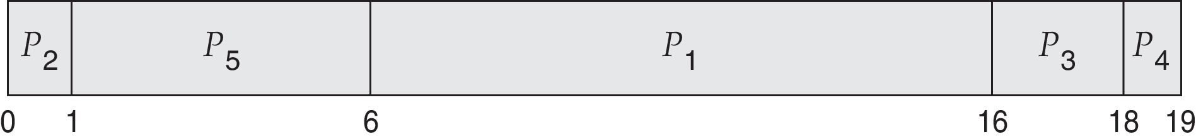
Example of Priority Scheduling
Process Burst Time T Priority
P1 10 3
P₂ 1 1
P₃ 2 4
P₄ 1 5
P₅ 5 2
Priority scheduling Gantt Chart
Average waiting time = 8.2 msec

Slide 31
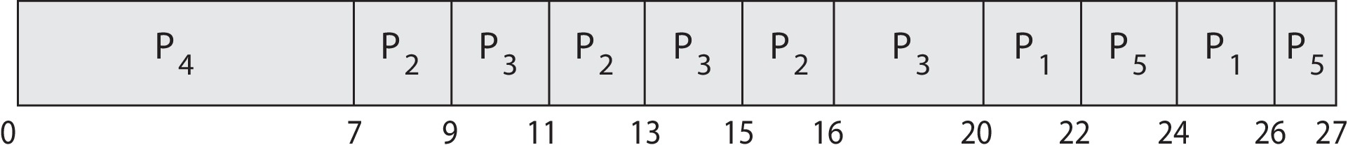
Priority Scheduling w/ Round-Robin
Process Burst Time T Priority
P₁ 4 3
P₂ 5 2
P₃ 8 2
P₄ 7 1
P₅ 3 3
Run the process with the highest priority. Processes with the same priority run round-robin (q=2)
Gantt Chart wit 2 ms time quantum

Slide 32
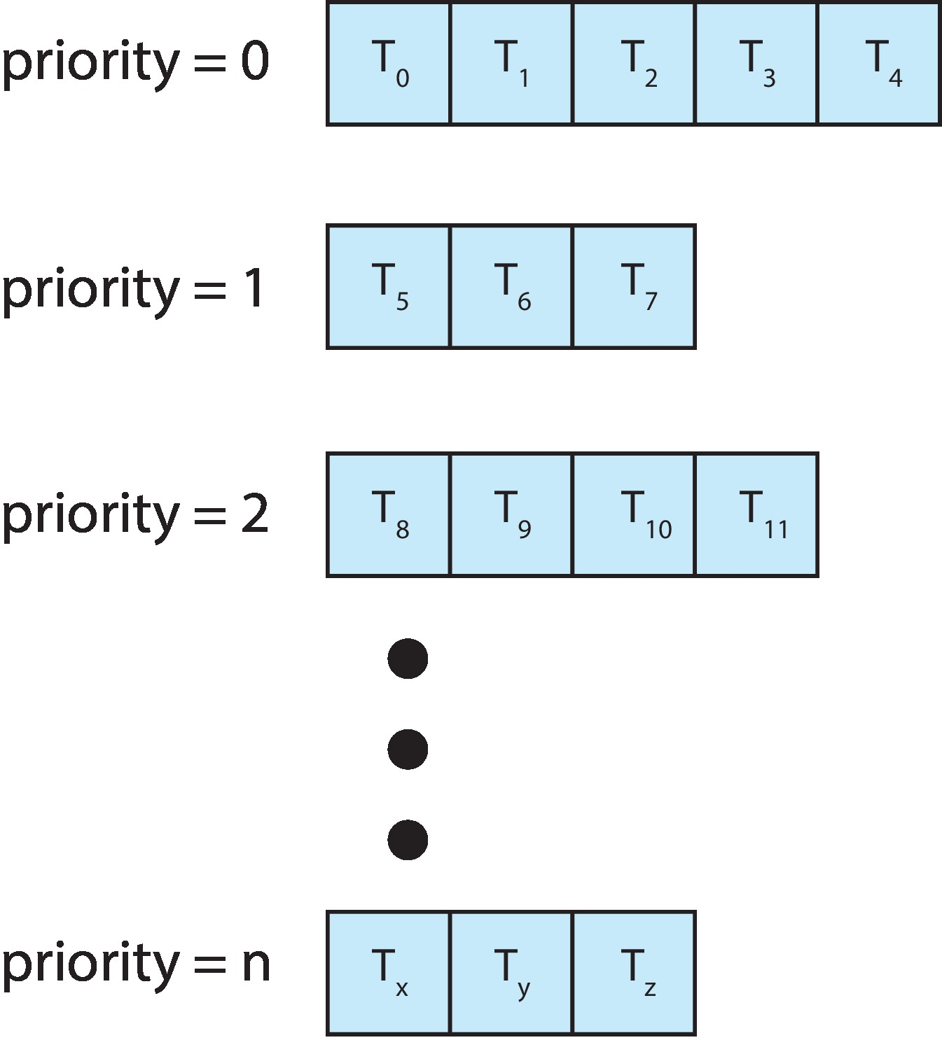
Multilevel Queue
With priority scheduling, have separate queues for each priority.
Schedule the process in the highest-priority queue!

Slide 33
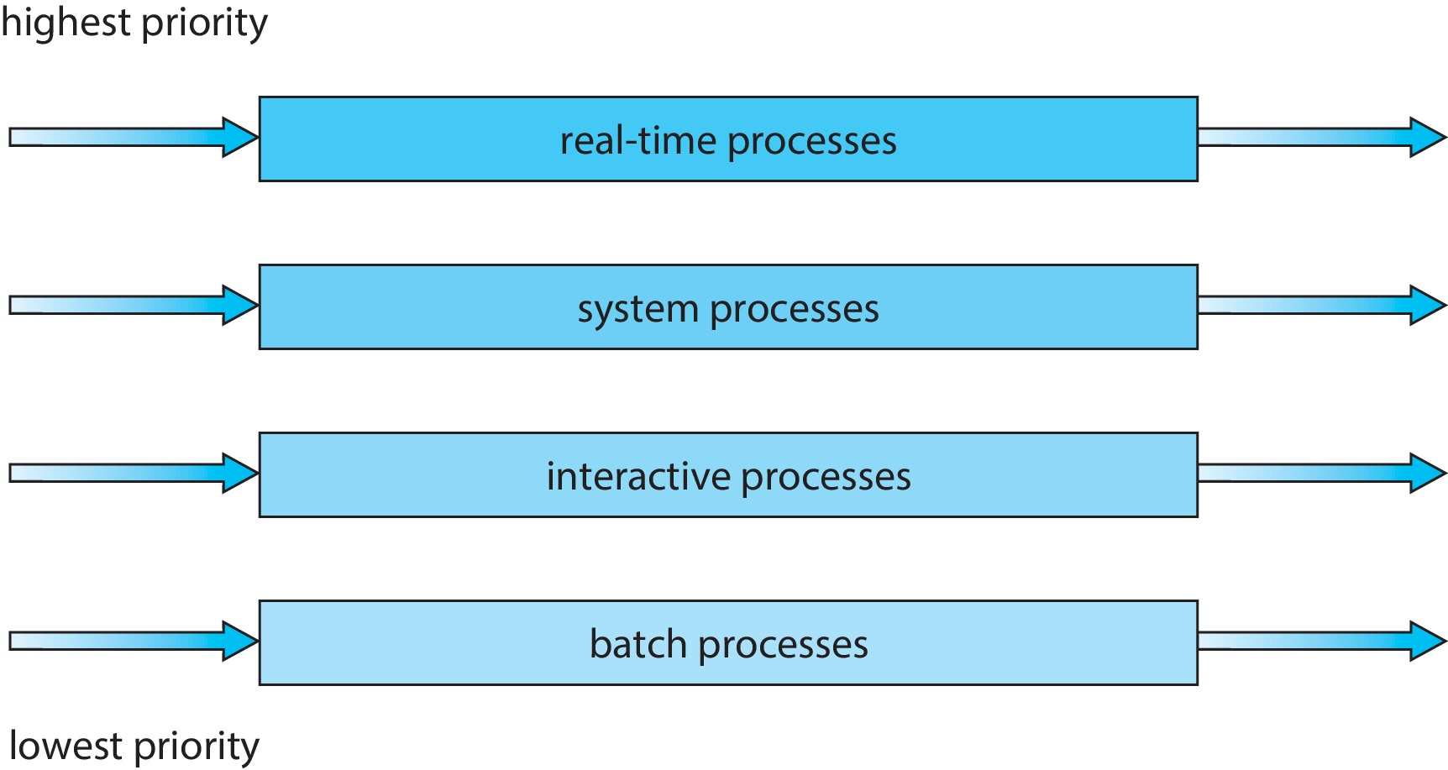
Multilevel Queue
Prioritization based upon process type

Slide 34
Multilevel Feedback Queue
A process can move between the various queues; aging can be implemented this way
Multilevel-feedback-queue scheduler defined by the following parameters:
number of queues
scheduling algorithms for each queue
method used to determine when to upgrade a process
method used to determine when to demote a process
method used to determine which queue a process will enter when that process needs service

Slide 35
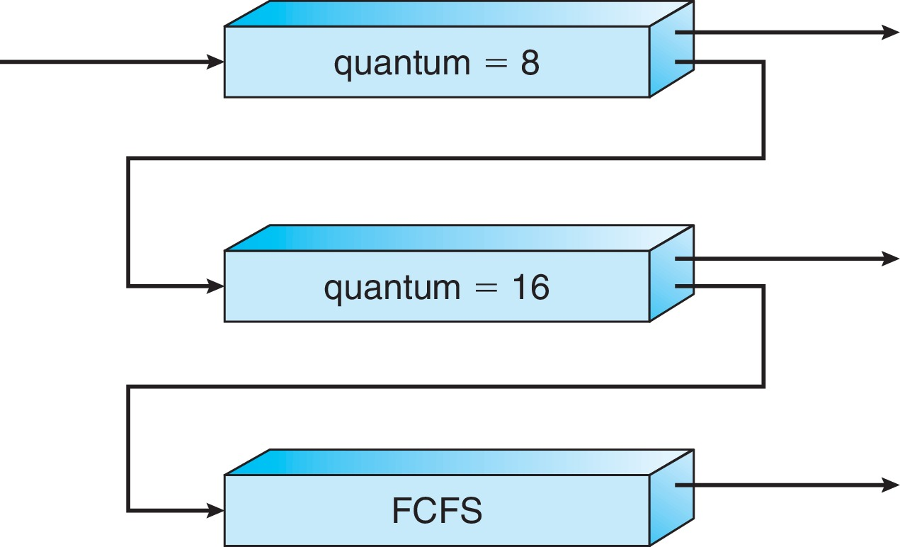
Example of Multilevel Feedback Queue
Three queues:
Q₀ – RR with time quantum 8 milliseconds
Q₁ – RR time quantum 16 milliseconds
Q₂ – FCFS
Scheduling
A new job enters queue Q₀ which is served FCFS
When it gains CPU, job receives 8 milliseconds
If it does not finish in 8 milliseconds, job is moved to queue Q1
At Q₁ job is again served FCFS and receives 16 additional milliseconds
If it still does not complete, it is preempted and moved to queue Q₂

